Slide 1

Active Defense for web apps: making an attacker’s life difficult

Slide 2
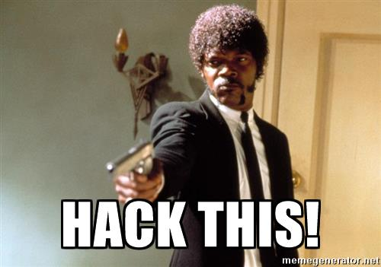

Slide 3

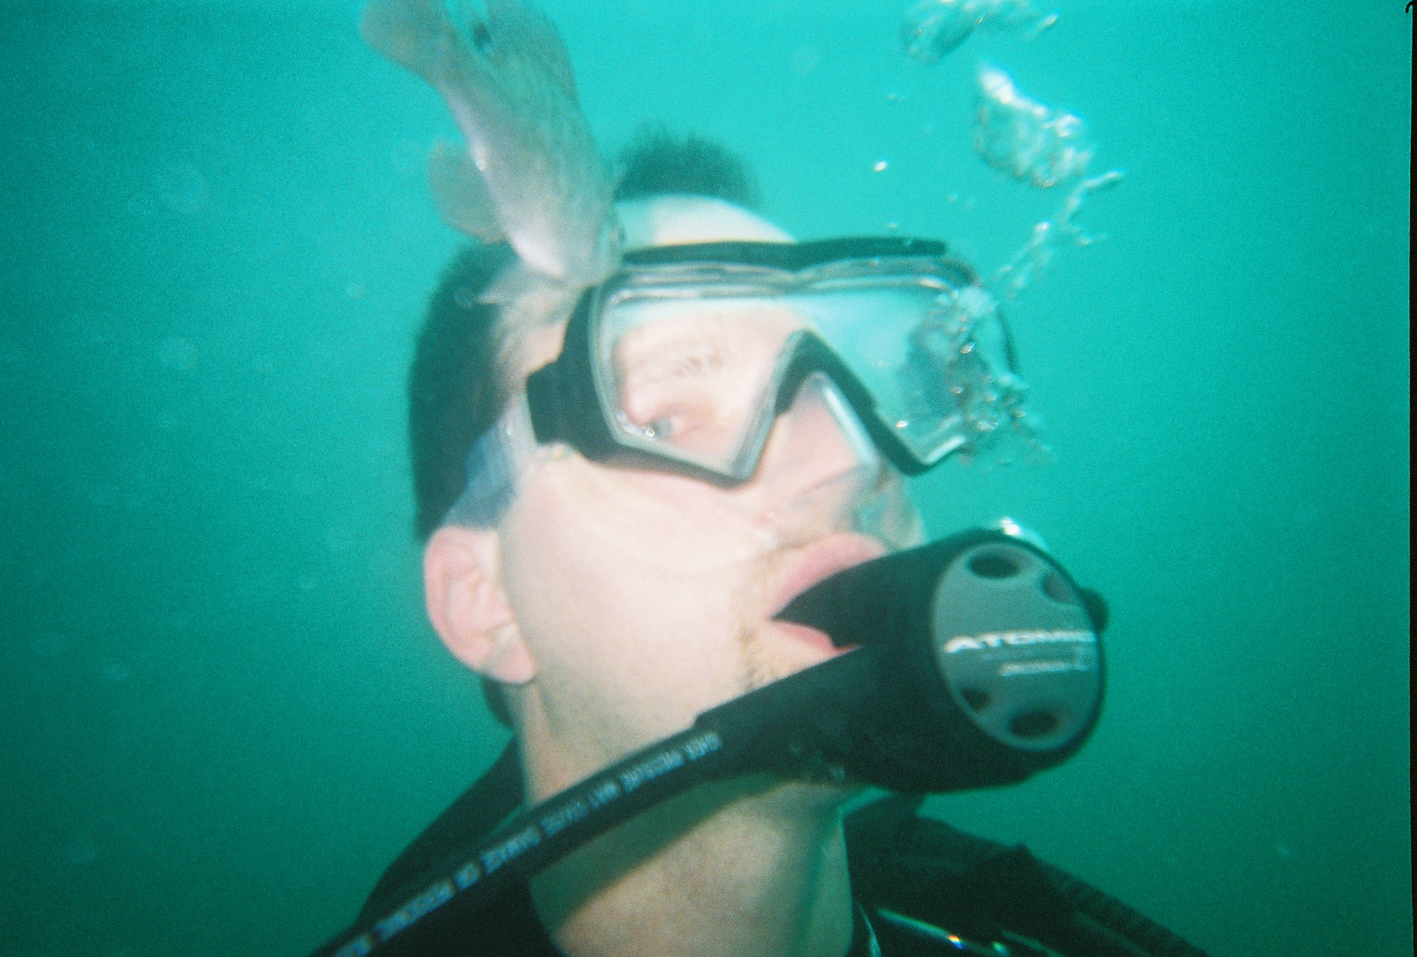
About Me
Husband
Avid scuba diver
Info Security Analyst
https://github.com/griddd

Slide 4
Agenda
Theory of active defense
Practical things you can do to cause annoyance, delays and frustration to your attackers…or pen-testers ☺
A mix of items that can be done throughout IT (e.g. system admins, DBAs, programmers, etc)
Questions/comments
Notes:
Theory will be down-to-earth…I hate stuff that is hand-wavy
I can (and do) policy work, but I’m an in-the-weeds guy

Slide 5
What is active defense?
https://en.wikipedia.org/wiki/Active_Defense
Anything you do that makes an attacker’s life harder
Active defense assumes you will be attacked
Usually involves deception, misdirection, etc
Doing it well requires you think like an attacker
Notes:
Borrows from the military
It’s a given that web apps are under attack. Don’t believe me, just look at your webserver logs

Slide 6
Can/should I attack the attacker?

Slide 7


Slide 8
What about frustrating/deceiving the attacker?

Slide 9


Slide 10
When?
Can do active defense at any time, but I feel it’s most useful after getting your applications in good shape security-wise
Via testing, and good defensive coding practices
Maybe after having done a pen-test, and gone through the results

Slide 11

Theory of Active Defense
To mount a successful attack, villains need info. What if they get false info?
Attack tools are written just like regular software: assuming certain database/coding/platform standards.
What if you don’t follow the standards?
Many tools use a fingerprint database to identify targets. Use that knowledge to your advantage!
Predictable resource names & locations…bad guys love these! Don’t be predictable: change defaults.
Block traffic from “unfriendly” IP netblocks
Some businesses blacklist Russia, China, North Korea…
Might work, depending on your business rules
Notes:
Nmap has a huge fingerprint database which is used to identify targets, check it out. Run scripts in debug mode; they often show you the fingerprints they use
Dirb has a wordlists of predictable resource names & locations
I hate singling out countries, but if you see a lot of attack traffic from an area…what else can you do?
Dig through the source of sqlmap, recon-ng modules, etc. Look at the tools of the villains

Slide 12

Stuff for system/server admins & DBAs
If you use IIS, configure all bad HTTP status codes to respond with the same error page
Sift your webserver logs…you’ll find good stuff there that can be used to misdirect/fool attackers
Within sensitive database tables, plant "watermark" or "canary" data. That is, insert real-looking, but fake, records that you can find in case of a compromise, Pastebin data dump, or something traveling outbound that shouldn't be. These can be rules you can integrate into your IDS/IPS.
Use a honeypot (home built or off-the-shelf)
Embed spaces in your database table names
This is almost certain to cause problems with attack tools like sqlmap, bbqsql, etc
Just remember to reference those tables inside [ ]
Notes:
Give the villains what they are looking for
Consider planting a false internal IP on your SSL certs. There’s an nmap script ssl-cert-intaddr that looks for this
Good & easy to use honeypots are Kippo or Cowrie. Be sure to configure them to look/act like a real server

Slide 13

Practical stuff…or how to lead attackers astray

Slide 14

Provide false info, and bad guys will make false assumptions
Plant an unlinked directory, with fake juicy info in it.
Any directory in a default word list from dirb will do
Nest a few directories for better effect
/sap/hana/admin/, /a2billing/customer/iridium_threed.php, /admin/images/tango.png, /invoker/JMXInvokerServlet, /admin/module-builtin.xml
Have a default.aspx page that does a server-side redirect to landing page. This can confuse some tools.
Fake info files in your web root (index.bak, crossdomain.xml, clientaccesspolicy.xml, elmah.axd, trace.axd)
Plant fake comments in HTML
Fake Google dork result in HTML
See https://www.exploit-db.com/google-hacking-database/ for some ideas
Notes:
On your landing page, try making an invisible image tag with an HREF back to your default.aspx. Might cause a loop in automated scanning/crawling tools…mwa ha ha!
Also, set an alert when this page is accessed…now you know someone is scraping your site

Slide 15


Slide 16

More fakery
Plant unused hidden fields in your ASPX pages
Use a favicon.ico that doesn’t match your platform
Change your X-Powered-By HTTP response header to something that doesn't match your platform
Add a useless but interesting HTTP response header in your webserver (e.g. set cookie)
Use special characters in your form field names, like txtBal$heet or ddlMor&stuff
Can cause issues with attack tools…mwa ha ha!
Could even go one step further with HTML encoded names…like ddlName&lt
Plant fake Generator meta tags within webpages
<meta name=Generator content=“MS Word 2000”>
Notes:
Stole the field special character thing from one of our vendors. I managed to work around it, but it was a pain
Visual Studio may not allow some special characters to be used

Slide 17

Even more fakery…
If your application uses stored procedures through a single DB user, name the user "Admin", "DBadmin" or somesuch
An attacker who sees this is likely to assume the existence of an over-privileged account
Setting a non-standard character set via HTTP request header Accept-Charset sometimes helps
Can cause problems for sqlmap & other SQL injection tools
Add an unused query string parameter to your URLs
Will cause an attacker to waste time looking for SQL/code injection that isn't there
Return a random amount of junk data from a client HTTP GET or POST request. This will stifle vuln discovery via fuzzing.
Plant juicy-looking but unused HTTP request meta tags within webpages
<META HTTP-EQUIV="X-Cookie" CONTENT="09ead097096895457e676d5c776ac455b4593dd0">
Notes:
We fooled a security vendor with the first one ☺
.NET Framework has a random class which will work. dotnetperls.com/random has some good examples
Double up…combine random junk data with a fake cookie
BurpSuite uses the section sign (legal statute symbol, overlapping S) unicode U+00A7 as a payload marker. Insert that in your code to stifle fuzzing

Slide 18
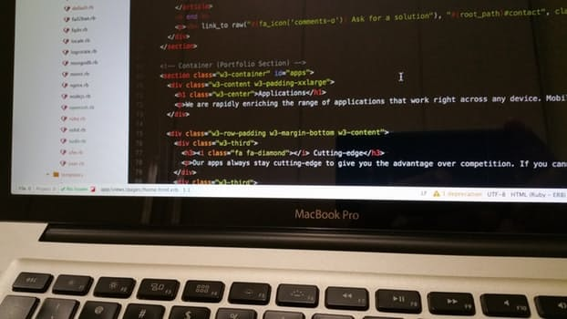

Conclusion
Bad guys will get in your head…don’t be afraid to get in theirs
Familiarize yourself with the tools, techniques, and practice of villains
Go to some hacker conferences: DerbyCon and SkyDogCon are local and inexpensive
Carefully document your use of fakery, so the technical staff isn’t confused
Notes:
Bit of a plug on the conferences…have attended both for years & spoken at each

Slide 19

Questions/Comments?

Slide 20
Thanks for coming!
Slides and notes will be up at https://github.com/griddd/DerbyCon2017
diverdown10 at gmail.com
I’ll be around…stop and chat ☺

